Slide 1


USE OF BUILDING INFORMATION MODELING TO PLAN ENERGY EFFICIENT APARTMENT BUILDINGS
Presented by : P.A.G.D. Balasuriya (170057U)
Supervisor s : Dr. Piyaruwan Perera
Dr. Kasun Kariyawasam
Co-Supervisor : Prof. (Mrs.)Chintha Jayasinghe
Notes:
Good evening everyone.
I’m Gayashan Dananjaya Balasuriya and my research topic is “Use of building information modeling to plan energy efficient apartment buildings”

Slide 2

Content
Introduction
Problem statement
Scope of the study
Objectives of the research
Literature review
Methodology
Case study
Results
Validation
Contribution to the research
Time plan
Reference
Notes:
This is the order of content I’m going to follow.

Slide 3
Introduction
In Sri Lanka, the building sector consumes about 35% of total energy generated in Sri Lanka (ADB and UNDP, 2017).
BIM based energy performance assessment in the design stage is essential for the green building design (Moakher and Pimplikar, 2012)
The life cycle energy and cost can be evaluated with BIM based web solutions or softwares (Moakher and Pimplikar, 2012)
Notes:
The building sector in Sri Lanka consumes around 35% of total energy.
It is a considerably high amount and should be reduced in order to tackle the energy crisis in Sri Lanka.
To reduce the energy consumption of the building sector it is needed to reduce the energy demand.
To reduce the life cycle energy demand, the most convenient method is to do a BIM based energy performance assessment at the design stage.
Then it will help to evaluate life cycle energy, cost and carbon performance.

Slide 4


Problem Statement
Software assess the energy and cost for the materials that assigned in the BIM model
How to select which material combination matches for the user requirements?
This research will give optimum material combination considering both cost and energy
Notes:
If we move onto the problem statement, Nowadays there are many software and web based solutions to assess the life cycle cost, energy and carbon performance of a building.
But many of these softwares assess the building materials that are already assigned to BIM model and give the results.
Therefore, we have to select the building material combination before using these currently available softwares.
So how to select which material combination should be used in the buildings?

Slide 5
Significance of the research
Problem addressed by a developed software tool
With the use of this automated tool,
Quantitatively measure energy, cost and carbon performance
Select material combination as per user requirements
Identify most energy efficient building orientation
Anyone can use the automated tool
User can edit, add or remove alternative materials
Developed industry ready software tool
Notes:
Let’s discuss the significance of the research
The previously identified problem is addressed by developing an automated software tool
With the use of this automated tool user can,
Quantitatively measure energy, cost and carbon performance
Select material combination as per user requirements
Identify most energy efficient building orientation
Also this tool can be operated by anyone who even doesn’t have knowledge of complex analysis
Also the user can edit, add or remove alternative materials in the database and compare only the necessary materials

Slide 6
Scope of the study
Conventional and alternative materials available in the local market and different systems(HVAC) are considered (Heating process is not assessed)
Multi-storey multi-family residential buildings in Sri Lanka and related data are considered in the study
Energy and cost components which will vary with the building envelope materials are assessed
Notes:
If we move onto the scope of the study, This study focus only about the different building envelope materials available in the local market and HVAC systems.
The space heating process is not considered in this study as it is not common in Sri Lanka.
Only the multi-story multi-family residential buildings are assessed and only selected energy and cost components are evaluated.

Slide 7
Main objective
Sub objectives
Analyze the model with various upgrades and their combinations
Assess results using MCDM approach and develop an automated tool to select optimal upgrades for building
Develop a practically applicable tool, which can be used to plan energy efficient and cost-effective apartment buildings
Notes:
The main objective of this research is to ……
The main objective is achieved by two sub objectives, which are …

Slide 8
Literature review
Authors | Key points
Yang & Wang, (2013) | Different LCA and LCC tools developed for specific regions North America – Athena Eco Calculator Germany – LEGEP software
Marzouk et al., (2018) Moakher & Pimplikar, (2012) | Database development in Autodesk Revit Material data extraction from the model
Moakher & Pimplikar, (2012) Nawarathna. & Fernando, (2017) | Building life cycle stages for analysis purposes Carbon emission during different stages
Rodrigues et al., (2020) Lu et al., (2017) | BIM based energy and carbon analysis methods Comparison of available methods for analyzing
Rodrigues et al., (2020) | Building envelope upgrade options
Notes:
These are some important key points in literature which helped to developed the software tool.

Slide 9
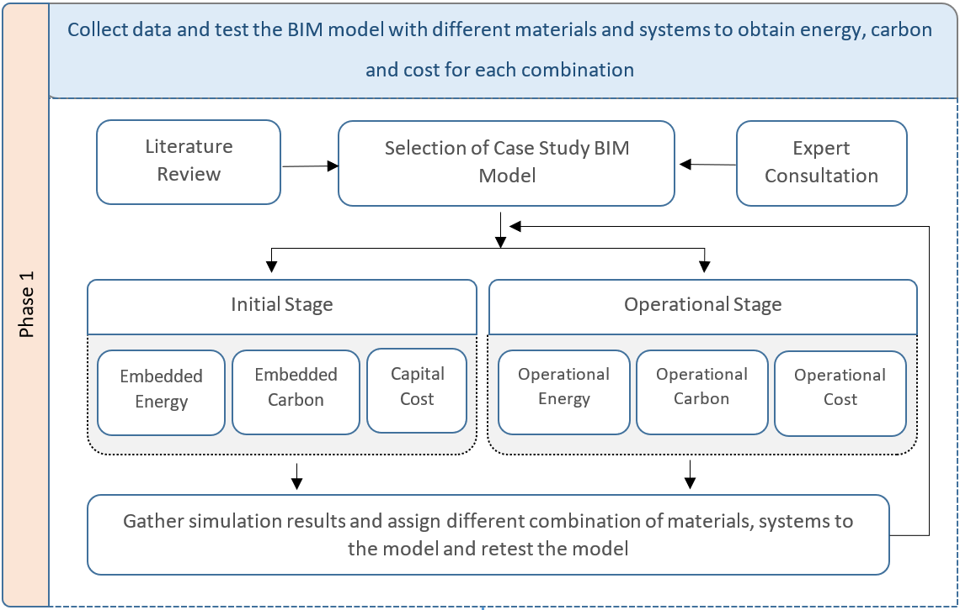
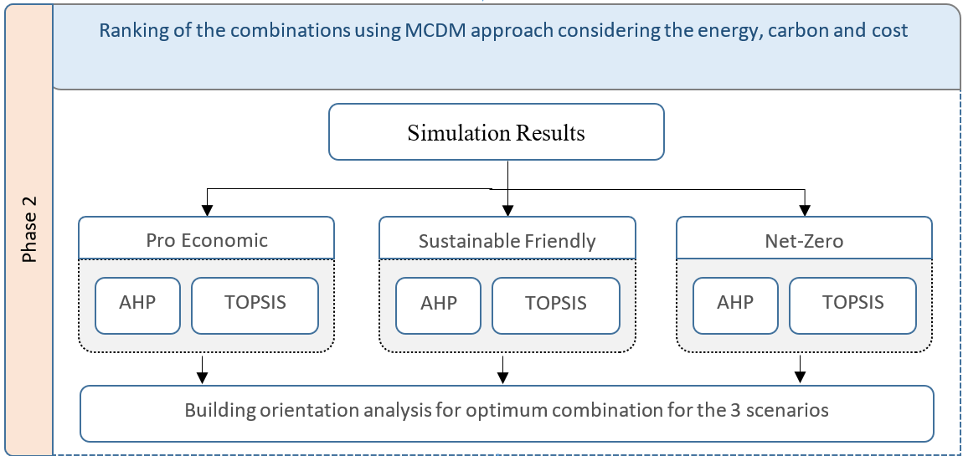
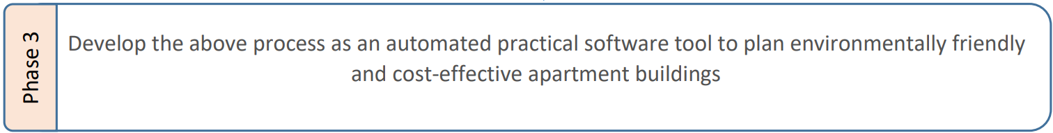
Methodology
Notes:
This is the methodology that I have followed and it has 3 phases.
The analysis of energy, cost and carbon is done in the phase 1 and the ranking of material combinations using MCDM approach is done in the phase 2
The first step in the phase 1 is to select the case study BIM model
Then it is evaluated for energy, cost and carbon emission separately for initial and operational stage
Then the simulation results are recorded and another material combination is assigned to the model and retest the model.
This retesting process is iteratively done until all the material combinations are assessed
The ranking process in the phase 2 is done for 3 different scenarios, pro economic, sustainable friendly and the net-zero scenario
For each and every scenario, the material combinations are ranked using AHP and TOPSIS method.
After that, the building orientation analysis is done to identify the most energy efficient direction.
The phase 3 is the software developing stage which include both phase 1 and phase 2.

Slide 10
Selection of upgradable options (Pre defined)
The upgradable options are selected by the major components in the building envelope (Yang & Wang, 2013)
External walls
External windows
External doors
External floors
Roof
Air conditioning systems
Building orientation
Notes:
These are the 7 upgradable options available in the developed tool.

Slide 11
Phase 1 – Assessing energy, cost and carbon footprint
This automated tool is developed with 2 software and can do the following steps by executing the developed Dynamo and VBA code
1st step
Revit BIM model Data extract to excel
2nd step
Excel data Simulation output
(Dynamo)
(Excel VBA)
Notes:
As described earlier, phase 1 includes the simulations of energy, cost and the carbon footprint.
There are 2 steps in this process, 1st one is to extract the data to excel from Revit BIM model using the dynamo scripting
The second step is to convert that extracted data to the simulation output using Excel VBA scripting

Slide 12
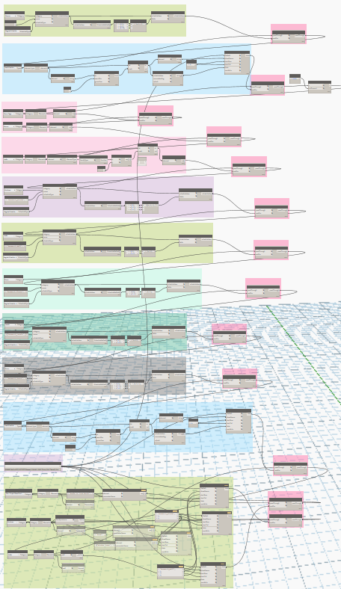
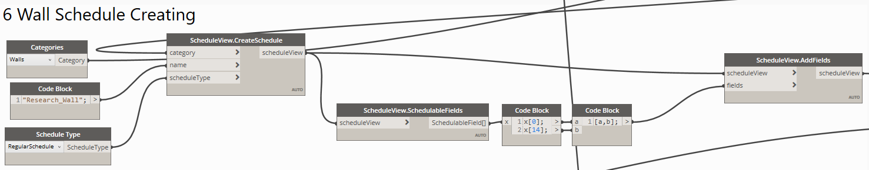
Dynamo code
Add parameters to schedule
Revit schedule creation
Parameter selection
(Area and wall facing direction)
Revit schedule type
Revit schedule name
Wall component selection
Notes:
This is the dynamo code that I have developed to create schedules.
A sample code is zoomed in and that part is developed for wall schedule creation.
Likewise, all the schedules are created for all the building elements and exported to excel

Slide 13
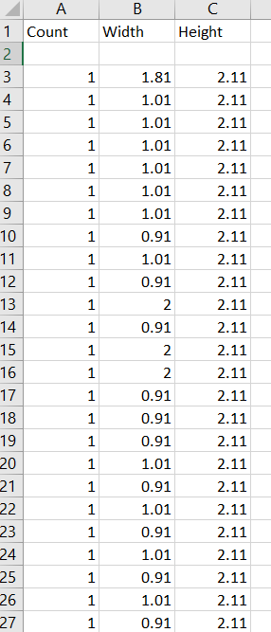
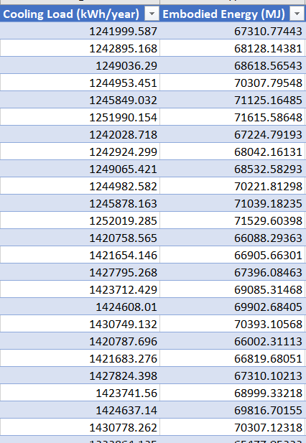
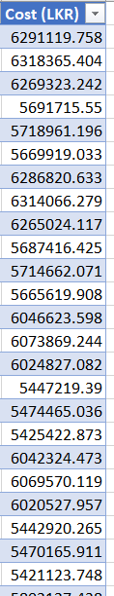
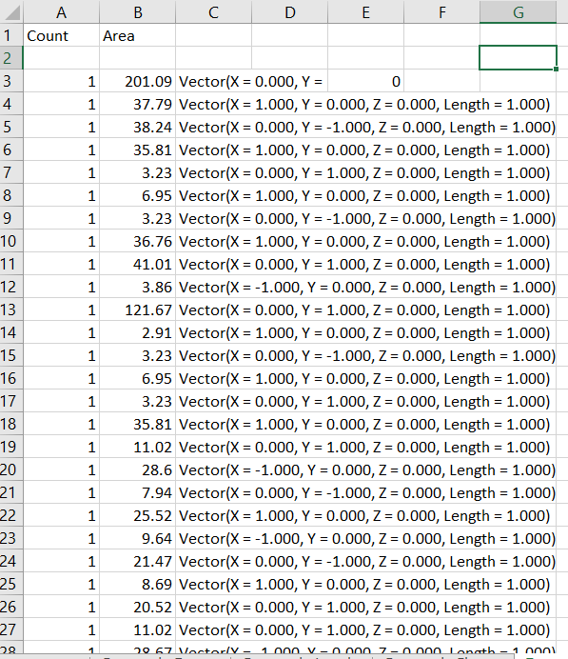
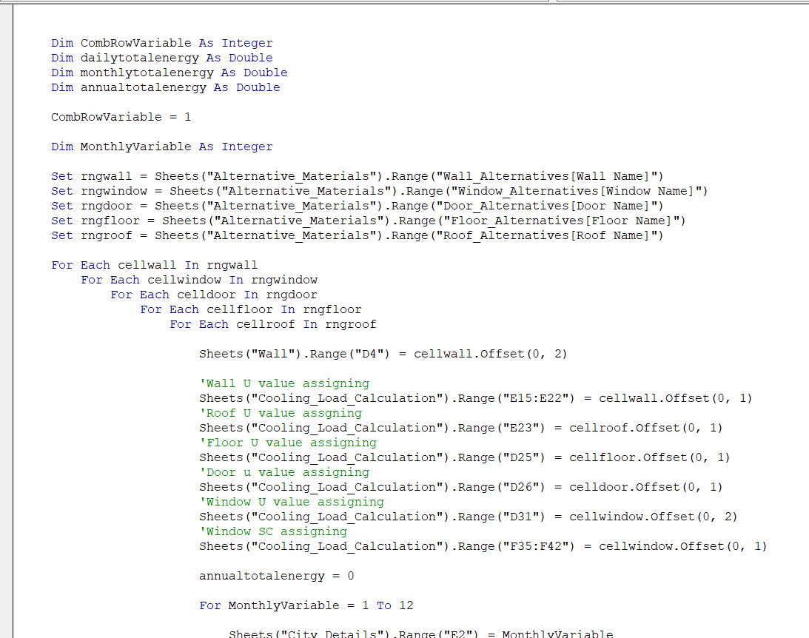
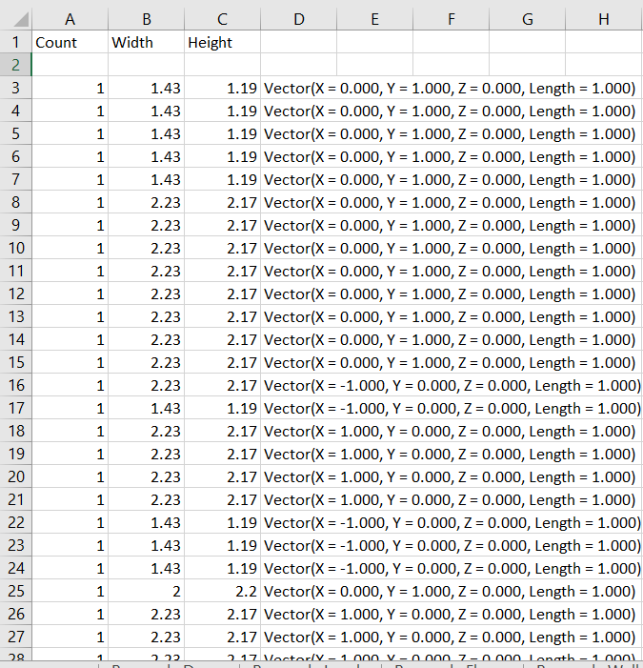
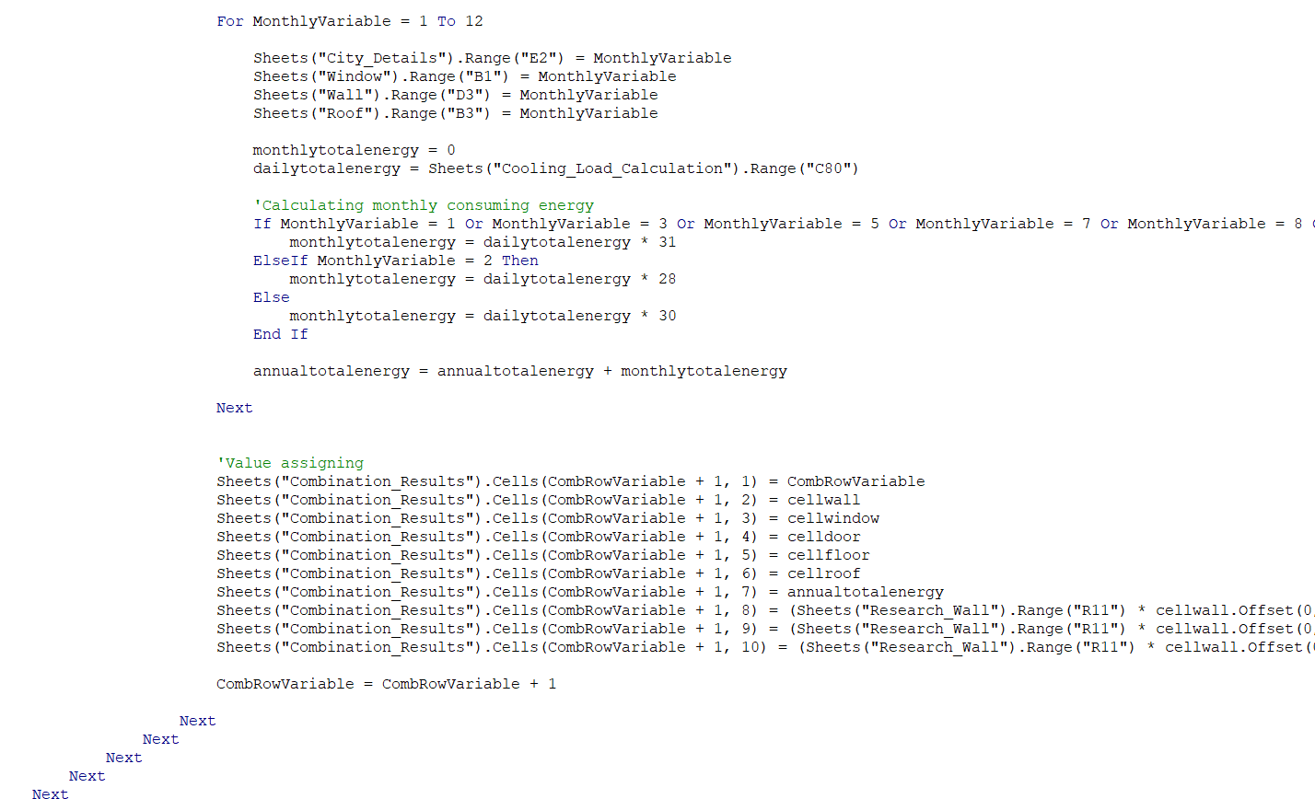
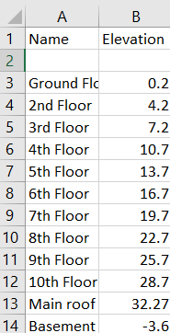
Excel & VBA coding
Creating combinations and analyze each combination for energy and cost
(Extracted data)
(Excel VBA script)
5524 lines
(Simulation output)
Notes:
After exporting to the Excel, the simulation output can be generated using the developed Excel VBA script.

Slide 14
Excel VBA code structure (With case study model data)
1. Formatting Exported Data
Doors
Floors
Walls
Windows
Total area
Total floor area, Avg. area, Population calculation, Building height
Area by wall facing direction. (N, NE, E, SE, S, SW, W, NW)
Area by window facing direction. (N, NE, E, SE, S, SW, W, NW)
Notes:
Let’s discuss the excel VBA code structure
The first step is to format the exported data.

Slide 15

2. Database development
Alternative material details
Windows -
Doors -
Roofs -
AC Systems -
Notes:
The second step is the database development.
The alternative materials and the relevant data is stored in the excel. The users of the software tool can edit, add or remove the alternative materials as per their requirements.

Slide 16
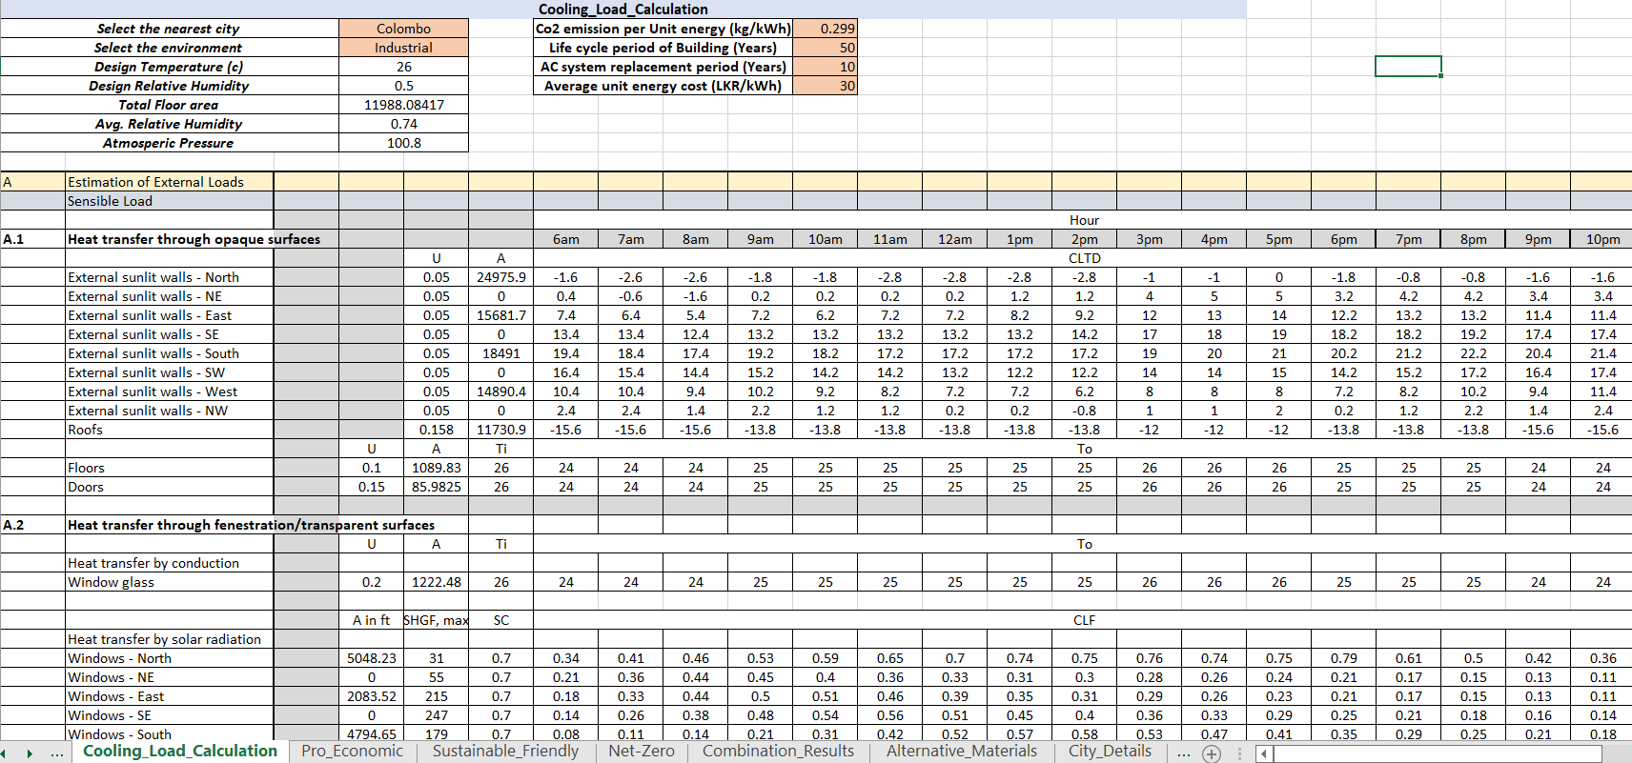
3. Energy Calculation (Cooling Load)
ASHRAE cooling and heating load calculation manual is followed
Basic details
Heat gain through walls
Heat gain by roof, floor & doors
Heat gain by window - Conduction
Heat gain by window - Radiation
Notes:
The 3rd step is the cooling load calculation process.
The ASHRAE cooling and heating load calculation manual is implemented in the tool.
There are several parts, the basic details are the main details of the building
Then several sections are created to calculate the heat gain by envelope

Slide 17
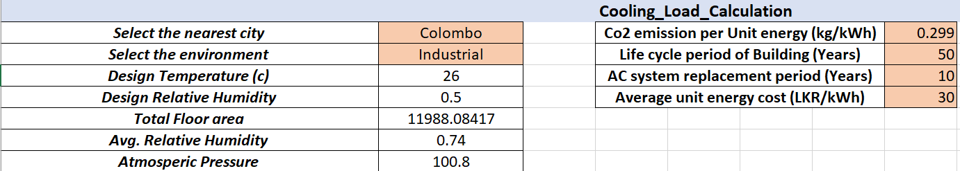
3.1 Basic details
User should enter relevant values to the highlighted cells
Selecting city Import relevant climatic data for calculation
Selecting environment Alter the variables in the calculation
Notes:
The basic details section has some parameters that can be updated by the software tool user.

Slide 18
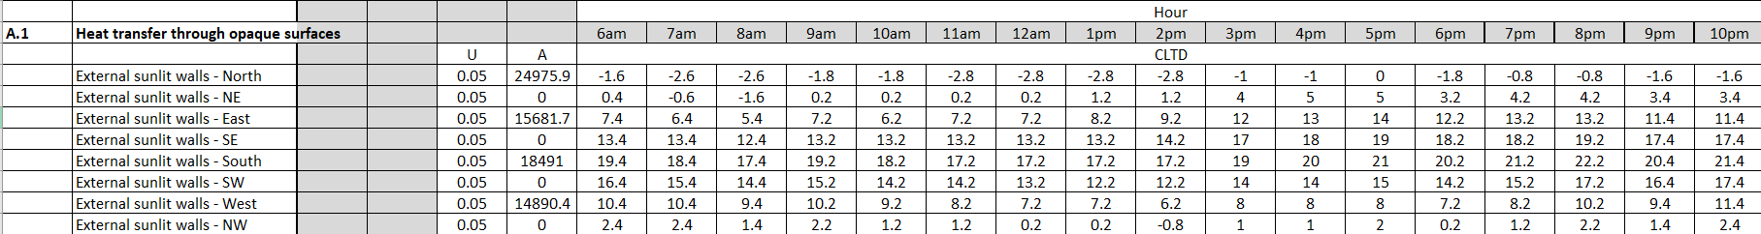
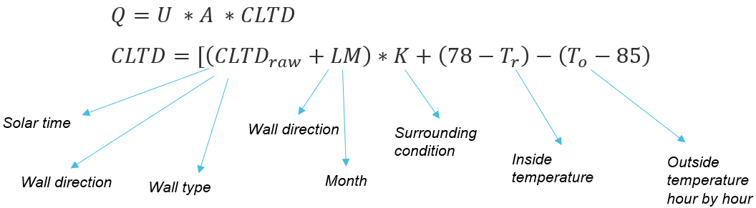
3.2 Heat gain through walls and roof
Imported by created
material database
Imported by exported
data tables
Imported by created
ASHRAE database
Variation of CLTD values
Vary with 12 months
Vary with hour by hour for a given month
Vary with latitude of the building location
Vary with Environment type (Industrial, rural)
Vary with wall material (7 types)
Notes:
The second section is the calculation of heat gain through walls and roof.
These calculations are done according to the ASHRAE handbook

Slide 19
3.3 Heat gain through floor and doors
Imported by created
material database
Imported by exported
data tables
Imported by created
Climatic database
3.4 Heat gain through windows - Conduction
Imported by created
material database
Imported by exported
data tables
Imported by created
Climatic database
Notes:
The same process is done to calculate heat gain through floor, doors
Conduction and radiation through windows are also calculated according to the ASHRAE handbook

Slide 20
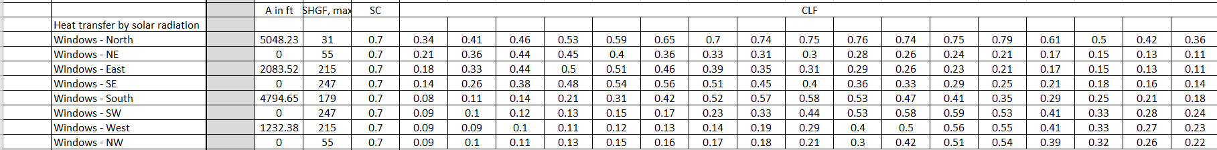
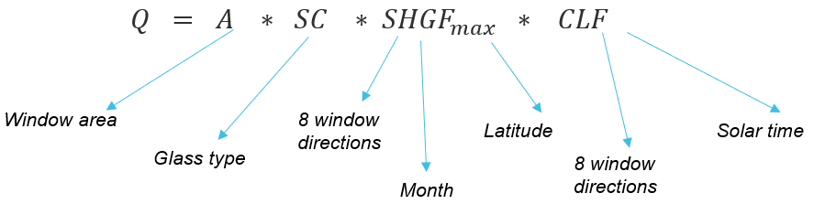
3.5 Heat gain through windows - Radiation
Imported by created
material database
Imported by created
ASHRAE database

Slide 21
3.6 Heat gain through ventilation
Vary with : outside hourly temperature, Humidity ratio, air pressure, ventilation rate and relative humidity
3.7 Heat gain by occupants
Vary with : number of people, sensible heat gain per person,
building type
3.8 Heat gain due to lighting, conduction through doors, windows and floors Vary with : heat transfer coefficients, area and temperature differences
Notes:
Same for the heat gain through ventilation, heat gain by occupants, heat gain due to lighting and conduction

Slide 22



4. Results at the end of phase 1
Energy
Cost
Carbon footrint
Peak cooling load
Annual cooling load Embodied energy
Operational energy (A/C)
Capital cost
Operational cost (A/C)
A/C system cost
Embodied carbon
Operational carbon (A/C)
Notes:
At the end of the Phase 1, these results can be determined related to energy, cost and carbon footprint

Slide 23
Phase 2 – MCDM approach and orientation analysis
Scenarios
Pro-economic
Sustainable friendly
Net-zero
AHP
TOPSIS
AHP
TOPSIS
AHP
TOPSIS
Notes:
Phase 2 is the ranking process of the material combinations.
There are 3 scenarios, pro economic, sustainable friendly and net-zero scenario. Each of the scenario has different weightages.
The ranking process is done independently for 3 scenarios using AHP and TOPSIS

Slide 24
Weightages for TOPSIS and AHP
Pro economic scenario
High weightages to cost components
Sustainable friendly scenario
High weightages to energy and carbon emission components
Net-zero scenario
Operational cost not considered
Operational carbon not considered
High weightages to energy and carbon emission components
Notes:
For pro economic scenario, high value is given to the cost component……..

Slide 25
Optimization of orientation
Steps of analysis
Assign optimum material combination
Every angle of 360 degree is analyzed for the energy
Select the most energy-efficient orientation
Notes:
After the ranking process, the orientation of the building is optimized.
There are 3 steps in this process, 1st one is assigning the optimum material combination
2nd step is to evaluate 1 degree by 1degree for the all 360 degrees
3rd step is the comparison and selecting the most energy efficient orientation

Slide 26
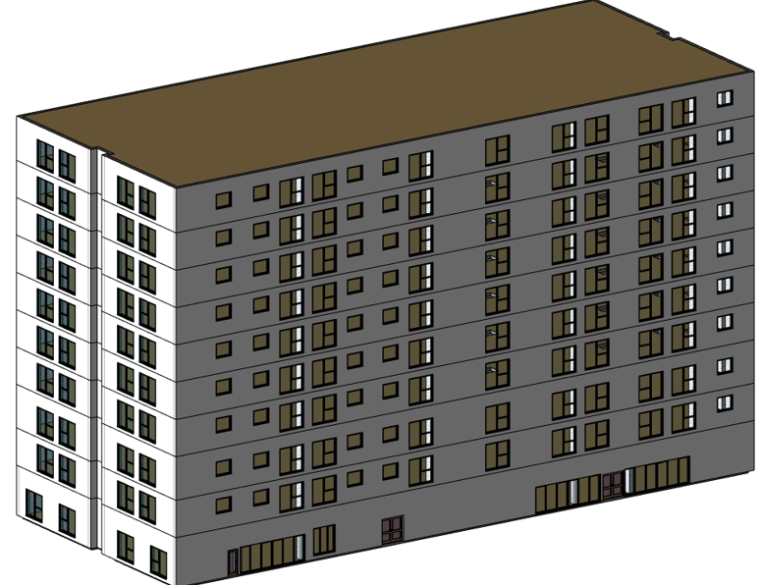
Case study BIM model
Floors of the building - 10
Residential units - 126
Total floor area - 11,076.6 m²
Revit BIM model
Notes:
This is the case study Revit BIM model used for the study.
This apartment building has 10 stories and 126 residential units
The total floor area is around 11 thousand square meters.

Slide 27
Results
Results generated by the developed Dynamo and Excel VBA code
Maximum Load kWh/hr | 460.1984263
No. AC Systems | 33
Cooling Load (kWh/year) | 1366100.598
Embodied Energy (MJ) | 47359.63573
LC Operational Energy (MJ) | 245898107.6
Capital Cost (LKR) | 6332337.659
Operational Cost (LKR) | 2049150896
System Cost (LKR) | 123624600
Embodied Carbon (Metric T) | 25.9845251
Operational Carbon (Metric T) | 20423.20393
Total Energy (MJ) | 245945467.2
Total Cost (LKR Million) | 2167.869234
Total Carbon (Metric T) | 20449.18846
Notes:
The developed Dynamo and Excel VBA code is used for this case study model and the following results are generated.
These results are related to the energy, cost and carbon emission

Slide 28
Validation
Validation of results by manual calculation, web services and software
The calculation process | Accuracy percentage | Validation method
Embodied energy | 100% | Manual calculation
Operational energy | 99.54% | Revit cooling load analysis
Capital cost | 100% | Manual calculation
Operational cost | 100% | Manual calculation
A/C system cost | 100% | Manual calculation
Embodied carbon | 100% | Manual calculation
Operational carbon | 100% | Manual calculation
AHP | 100% | Manual calculation
TOPSIS | 100% | Manual calculation
Orientation analysis | 100% | Autodesk Insight
Notes:
Let’s move onto the validation process
Previously generated results are validated by manual calculations and by different softwares.
All the results have 100% accuracy other than the operational energy calculation, which has more than 99% accuracy.

Slide 29
Conclusion
Research aim achieved (Developing of software tool)
High accuracy of developed software
Any user can operate the tool
According to the case study;
20.6% reduction of operational energy and cost
40.7% reduction of embodied energy
18.7% reduction of capital cost
24.2% reduction of A/C system cost
19.9% operational energy reduction due to optimum orientation
6.3% reduction of A/C system cost due to optimum orientation
Notes:
As the conclusion of the study, the research aim is achieved by developing a practically applicable software tool to plan energy efficient and cost effective apartment buildings.
The tool has a higher accuracy as the validation process shows
According to the case study, this software tool helps to reduce significant amount of energy, cost and the carbon emisssion

Slide 30
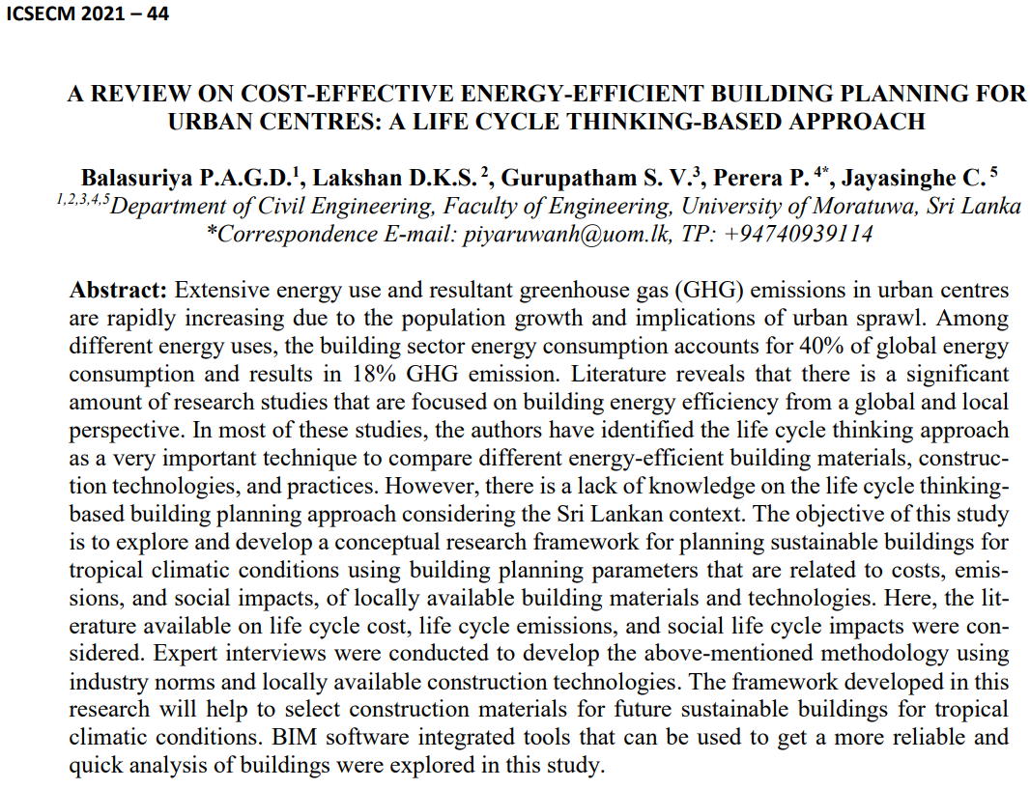
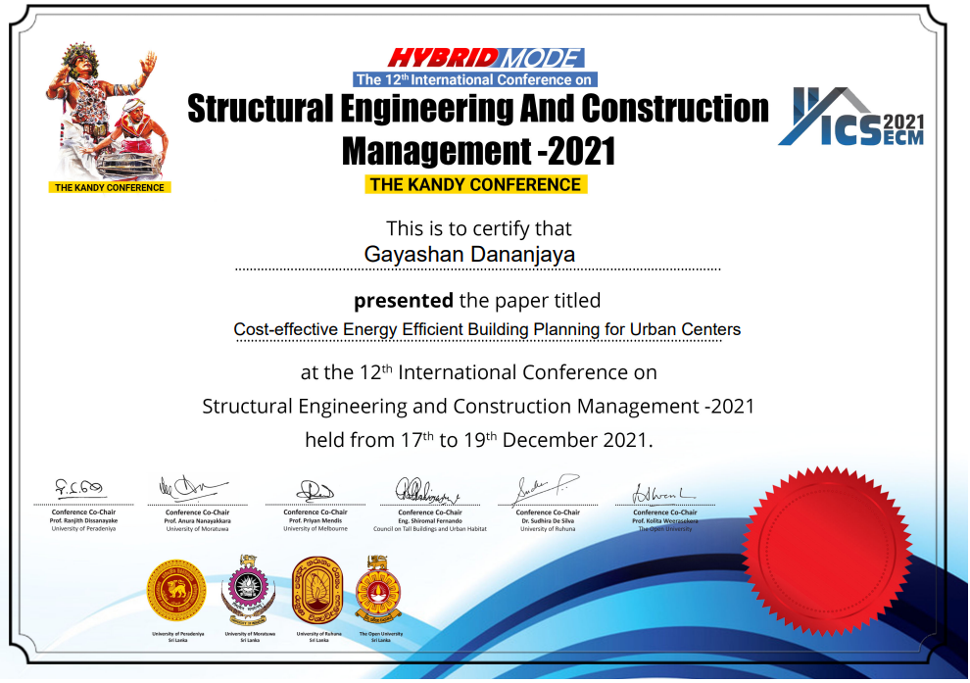
Contribution for the research (Conference paper)
Notes:
This is the presented conference paper at the 12th International Conference on Structural Engineering and Construction Management 2021

Slide 31
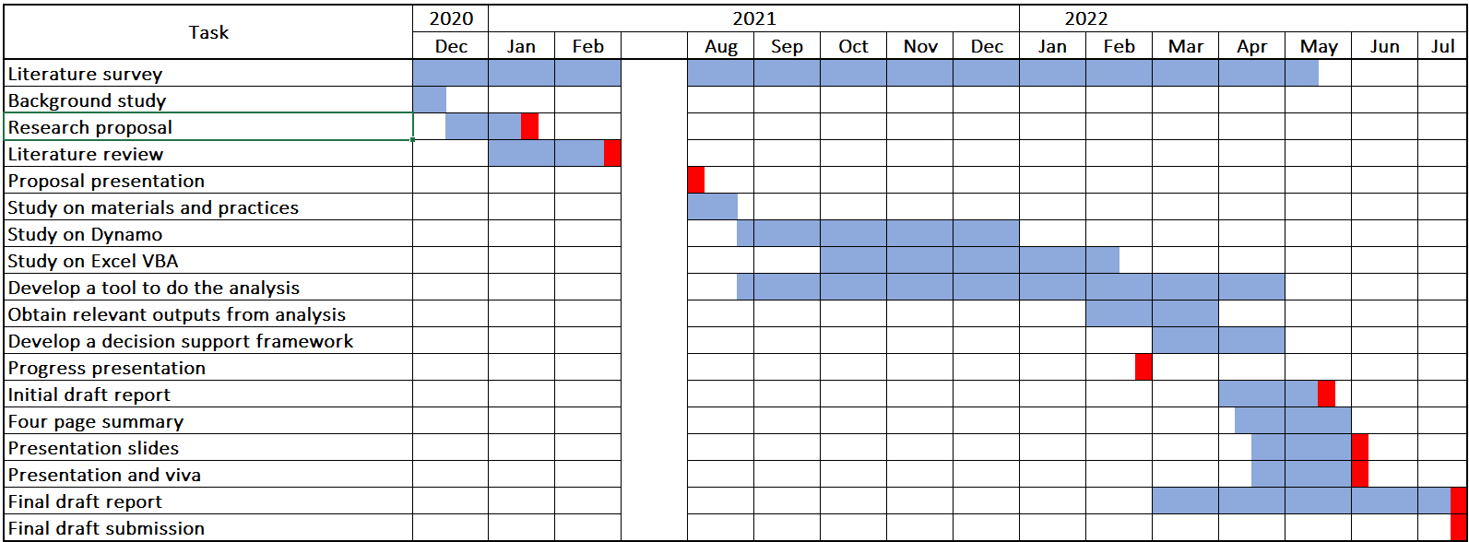
Time frame
Notes:
This is the time frame that I have followed throughout the research

Slide 32
References
ADB and UNDP (2017) ‘Assessment of Sri Lanka’s Power Sector-100% Electricity Generation Through Renewable Energy by 2050’, p. 122.
Moakher, P. E., & Pimplikar, S. S. (2012). Building information modeling (BIM) and sustainability–using design technology in energy efficient modeling. IOSR Journal of Mechanical and Civil Engineering, 1(2), 10-21.
Marzouk, M., Azab, S., & Metawie, M. (2018). BIM-based approach for optimizing life cycle costs of sustainable buildings. Journal of cleaner production, 188, 217-226.
Yang, W., & Wang, S. S. (2013). A BIM-LCA framework and case study of a residential building in Tianjin. Modeling and Computation in Engineering II, 83.
Nawarathna, A., Fernando, N. G., & Perera, S. (2017). Estimating whole life cycle carbon emissions of buildings: a literature review. In The 6th World Construction Symposium.
Notes:
These are the references used in the presentation

Slide 33
Rodrigues, F., Isayeva, A., Rodrigues, H., & Pinto, A. (2020). Energy efficiency assessment of a public building resourcing a BIM model. Innovative Infrastructure Solutions, 5(2), 1-12.
Lu, Y., Wu, Z., Chang, R., & Li, Y. (2017). Building Information Modeling (BIM) for green buildings: A critical review and future directions. Automation in Construction, 83, 134-148.

Slide 34

Thank You!
Notes:
I should thank Dr. Piyaruwan Perera, Dr. Kasun Kariyawasam and prof. (Mrs.) Chintha Jayasinghe for the given support and guidance.
Also I must thank Mrs. Sharon Vanmathy and Mr. Nipun Kumarage for the given support throughout the research.

